Slide 1

Duel Reality
Software Engineering
Spring 2010
Josh Kilgore
Obi Atueyi
Tom Calloway
Ye Tian

Slide 2
Summary
Overview
Modules
Graphics (Tom Calloway)
User Interface (Obi Atueyi)
Game Mechanics and AI (Josh Kilgore)
Database (Ye Tian)
Conclusion
Questions

Slide 3
Overview
This is an overview, there are many like it, but this one is mine
consists of an top level of the project
Description
Leads into greater discussion
Good place for component diagram

Slide 4
Game Graphics Module Presenter: Tom Calloway
What it is.
What it does.
How it works.

Slide 5
Game Graphics Module “What it is”
Region of the main dialog containing the two-dimensional graphics for the game itself.
Background consists of a static image representing the battle environment.
Top portion (generally the sky) serves as a header region for displaying information.
Lower region contains the game grid with units and objects in play.

Slide 6
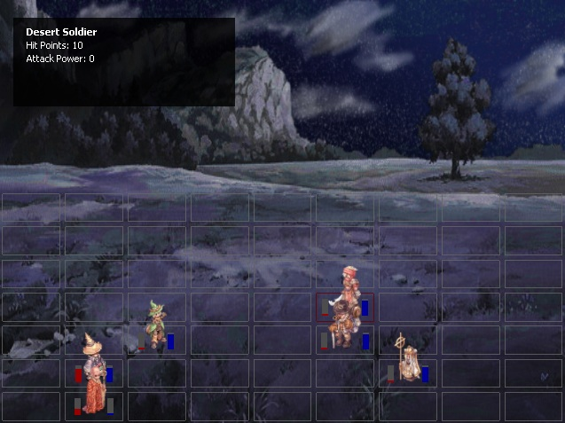
Game Graphics Module “What it does”

Slide 7
Game Graphics Module “What it does”
Accurately reflect the current state of the battle in progress through visual and auditory effects.
Grid displays all units with their health and action points.
Top region displays more detailed statistics for the current user-selected cell.
Allows loading and manipulation of content by both the players and external modules.
Handles movement, attack, and defeat of individual units as requested by the game mechanics and AI.
Handles interaction between the user and the game itself. Specifically, movement, selection, and attack of individual units is supported.

Slide 8
Game Graphics Module “Conclusion”
Graphics are crucial to any graphics based video game.
Connects the player to the game by accepting input and accurately presenting information.
Graphics must work well with the game mechanics.
2D overhead and grid were used to provide a solid correlation between the game’s mechanics and it’s graphics.

Slide 9
User Interface Module Summary
Function
Architecture
Model
Conclusion

Slide 10
User Interface Module Function
Provide the framework for the user interaction with the application
Provide the ability for the user to choose desired game settings
Provide status messages or display error messages if user attempts an invalid operation

Slide 11
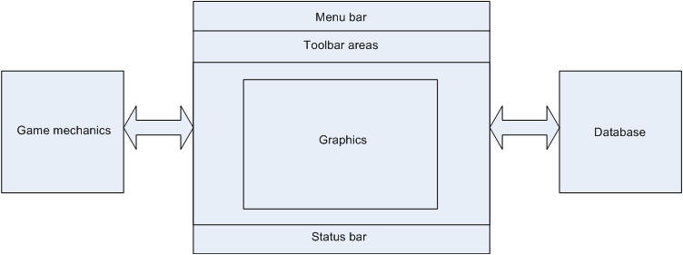
User Interface Module Architecture
Interaction with other modules

Slide 12
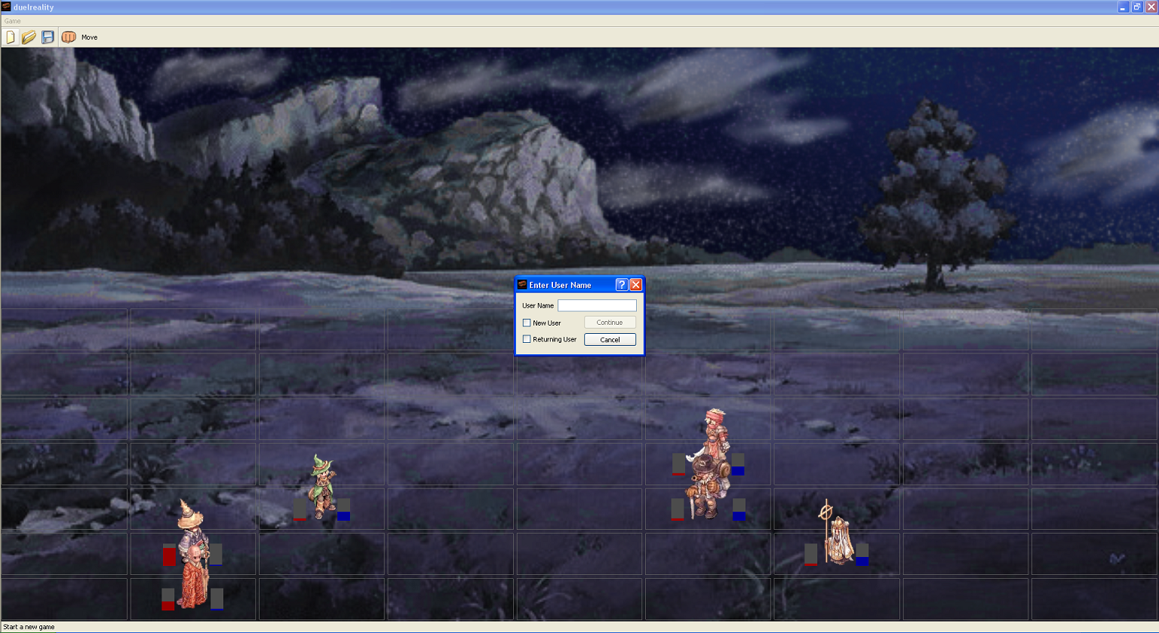
User Interface Module: Model

Slide 13
User Interface Module Conclusion
The User Interface module is what enables the application to respond to the user’s actions.
By communicating with the game mechanics and database modules, the User Interface shares, with the user, data necessary to configure the game
The User Interface module does not display graphics of the active battle, but rather provides the space to view the battle.

Slide 14
Game Mechanics and AI
Units
Mechanics
AI

Slide 15
Units
Units are cool
They have attributes
And do stuff

Slide 16
Game Mechanics
Discussion of Game Mechanics
How Movement and attack are achieved
Other functions
Class diagram

Slide 17
AI
Method used – Decision tree
Pretty Drawings

Slide 18
Game Mechanics & AI Conclusion
Units
Game Mech
AI

Slide 19
Database “Summary”
What Database is?
What Database does in the project?
How Database works?

Slide 20
Database “What Database is”
Databases consist of software-based "containers" that are structured to collect and store information.
Database programs are designed for users so that they can retrieve, add, update or remove information.
The structure of a database is tabular, consisting of rows and columns of information.
A number of database architectures exist. Many databases use a combination of strategies.

Slide 21
Database “What Database does in the project”
The game database contains all of data records
Tables collection of the names, parameters, status of all game units, and the game contents such as maps.
The data is retrieved and overwritten for synchronous/ asynchronous backup.

Slide 22
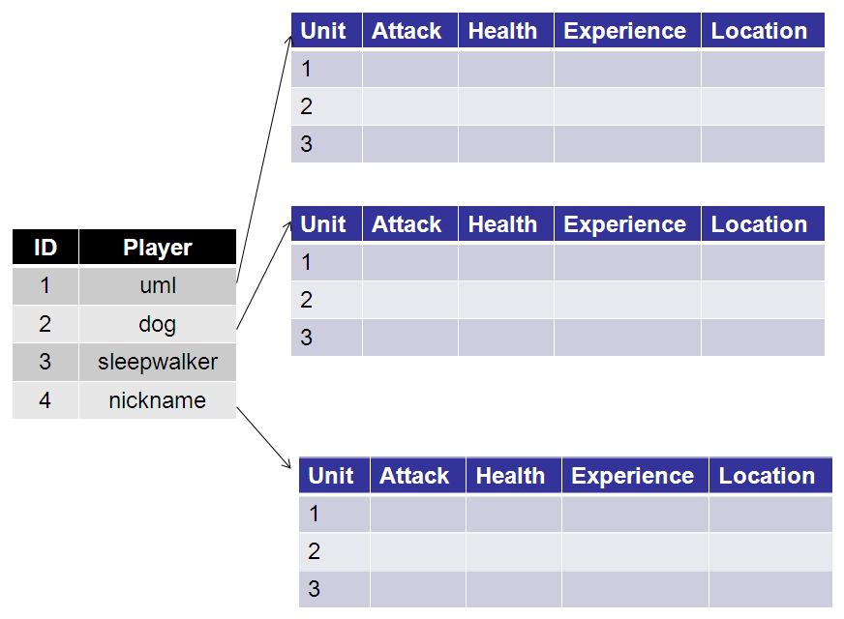
Database “How Database works”

Slide 23
Database “How Database works”
OpenGL
User
Interface
Game
Mechanics
Database
The database module interacts with other modules, but does not affect them. It shall provide operation function by other modules. Such as: read(); write().

Slide 24
Database “Conclusion”
Database functions like a background support to other modules.
Database provides good organization of the game data.
Database is useful for Storage and Retrieval of map and unit Data.

Slide 25
Summary

Slide 26
Conclusion
Conclude this presentation
Told you about our awesome game
Pre-orders available

Slide 27
Questions?

